Slide 1
Mobile price prediction Using Machine Learning
DA-Trainer & Guide :- S.V.Karthik
Learners Names :- 1) Sukanya Ghadage
2) Snehal Magdum

Slide 2

Content
Introduction
Problem Statement
Methodology
Machine Learning Models
Conclusion

Slide 3
Introduction
Mobile phones come in all sorts of prices, features, nd all. Price estimation and prediction is an important part of consumer strategy. Deciding on the correct price of a specifications product is very important for the market success of a product. A new product that has to be launched, must have the correct price so that consumers find it appropriate to buy the product.

Slide 4
Problem Statement
To predict the price range of a mobile phones.
The data contains information regarding mobile phone features, specifications etc and their price range. The various features and information can be used to predict the price range of a mobile phone.

Slide 5
Methodology
We will proceed with reading the data, and then perform data analysis. The practice of examining data using analytical or statistical methods in order to identify meaningful information is known as data analysis. After data analysis, we will find out the data distribution and data types. We will use 4 classification algorithms to predict the output. We will also compare the outputs.

Slide 6
Machine learning models
Random Forest Classifier
Super Vector Machine Classifier
Naïve Bayes
Decision Tree Classifier

Slide 7
1) Random Forest Classifier
A random forest is a supervised machine learning method built from decision tree techniques. This algorithm is used to anticipate behaviour and results in a variety of sectors, including banking and e-commerce.
A random forest is a machine learning approach for solving regression and classification issues. It makes use of ensemble learning, which is a technique that combines multiple classifiers to solve complicated problems.

Slide 8
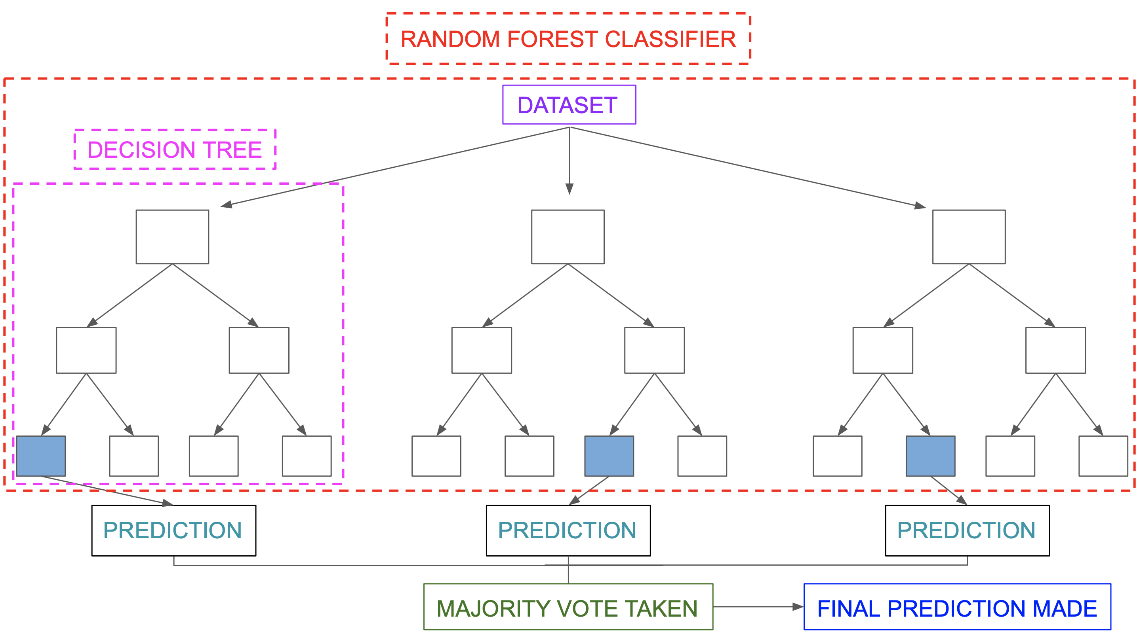

Slide 9
2) Super Vector Machine Classifier
Support Vector Machine, or SVM, is a prominent Supervised Learning technique that is used for both classification and regression issues. However, it is mostly utilized in Machine Learning for Classification purposes.
The SVM algorithm’s purpose is to find the optimum line or decision boundary for categorising n-dimensional space so that we may simply place fresh data points in the proper category in the future. A hyperplane is the optimal choice boundary.

Slide 10
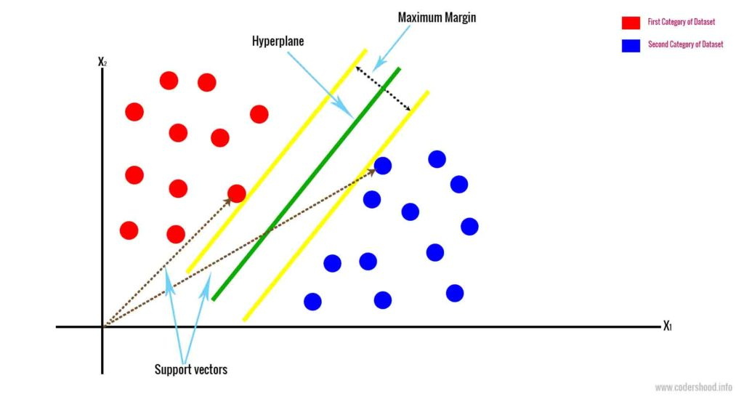
This Photo by Unknown Author is licensed under CC BY

Slide 11
3) Naïve Bayes
Gaussian Naive Bayes is a Naive Bayes variation that allows continuous data and follows the Gaussian normal distribution. The Bayes theorem is the foundation of a family of supervised machine learning classification algorithms known as naive Bayes. It is a basic categorization approach with a lot of power. When the dimensionality of the inputs is high, they are useful. The Naive Bayes Classifier may also be used to solve complex classification issues.

Slide 12
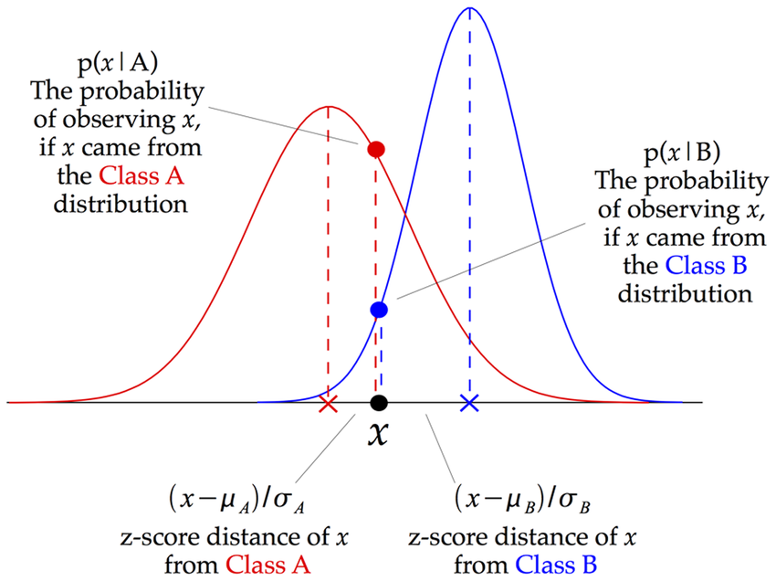

Slide 13
4) Decision Tree Classifier
Decision Tree is supervised machine learning that can be used for both classification and regression problems, but it mostly preferred for solving classification problems. It is a tree-structured classifier, where internal nodes represent the features of a dataset, branches represent the decision rules and each leaf node reprensts the outcome.

Slide 14
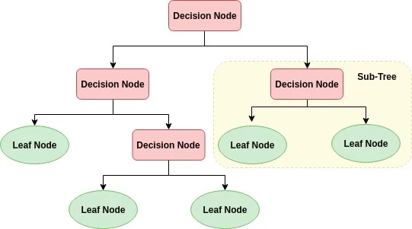
This Photo by Unknown Author is licensed under CC BY-SA-NC

Slide 15
Conclusion
In this problem, we looked at classification. Classifiers represent the intersection of advanced machine theory and practical application.
These algorithms are more than just a sorting mechanism for organizing unlabeled data instances into distinct groupings. Classifiers include a unique set of dynamic rules that include an interpretation mechanism for dealing with ambiguous or unknown values, all of which are suited to the kind of inputs being analyzed. Most classifiers also utilize probability estimates, which enable end-users to adjust data categorization using utility functions.
In this problem, we see SVM Classifier is perform well than other models.

Slide 16


